Slide 1
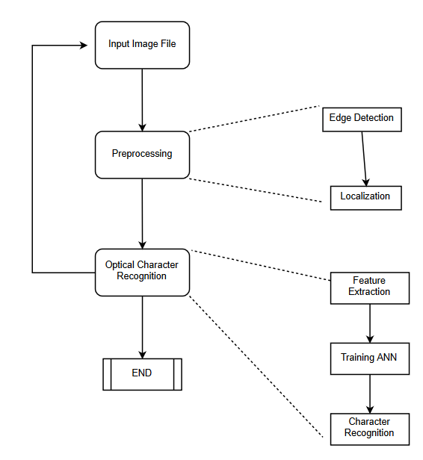
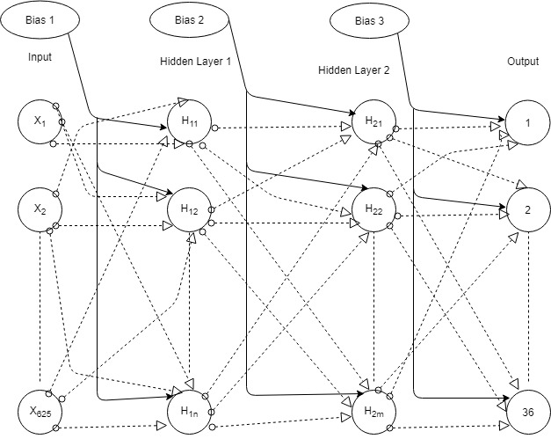
Automatic Number Plate Recognition
Department of Computer Science
Abhash Jain, Abhishek Srivastava, Ajay V, Darshan Bhandari, Deepak Gupta, Kamal Sharma
North Carolina State University
1. Introduction
3. Technical Details
5. Parameter choices
Automatic Number Plate Recognition using Image Processing and OCR.
ANN was used and exploration of CNNs.
The implementation is done in Python 2.7.
Division of the project is done into 2 modules:
1.Preprocessing of the image.
-Conversion of image to gray scale.
-Edge detection
-Segmentation
2.Optical Character Recognition using ANN.
Batch size = 16,
Learning rate = 0.01,
Network architecture = 2 Hidden layers (400, 300) nodes
Activation function = Sigmoid/ Relu/ Tanh
Optimization algorithm: Adam/ Gradient Descent
These choices were used as they have proved to be successful in all neural network implementations.
2. Data description
4. Results
6. Conclusions
The dataset consists of images of individual alphanumeric characters.
The test images consist of images of cars, with the number plate clearly visible and has minimum reflection.
The accuracy of each of the modules highly depends on a number of factors, also the performance of ANN is directly proportional to the quality of the segmented images.
The results generated from rigorous testing are as follows:
Neural Networks perform better for image classifications compared to other classification algorithms.
Adam optimization converges faster than gradient descent.
 | Accuracy
Plate Localization | 78.9%
Character Segmentation | 60%
OCR from the segmented characters | 55.66%
7. References
Bhavin V. Kakani, Divyang Gandhi, Sagar Jani, “Improved OCR based Automatic Vehicle Number Plate Recognition using features trained Neural Network.” IEEE-40222, ICCCNT
2017

